Slide 1
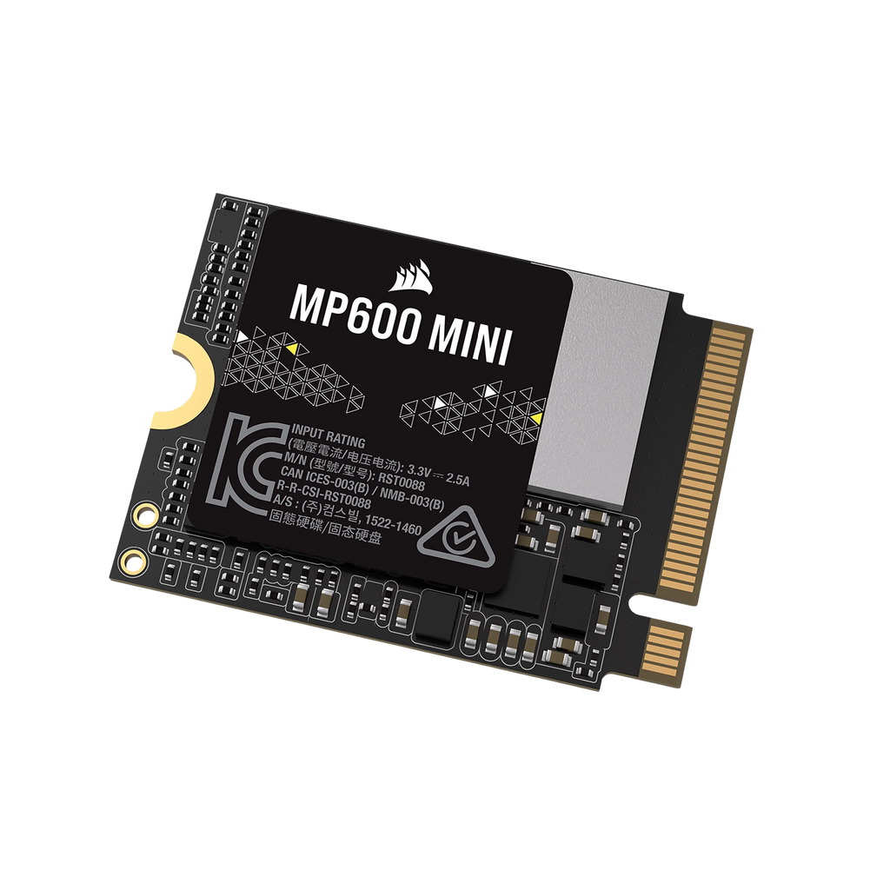
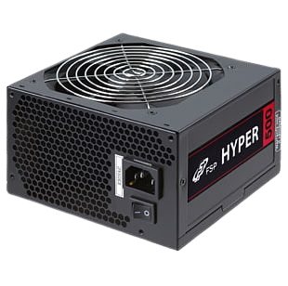
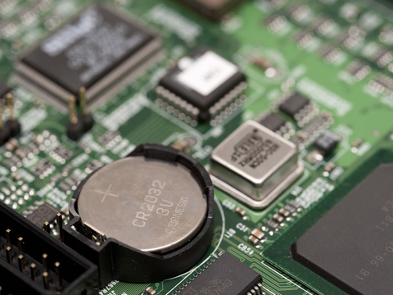
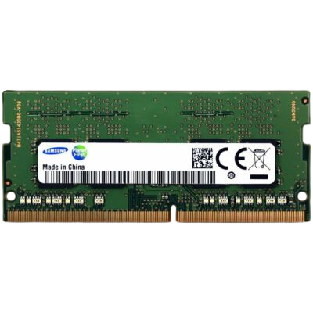
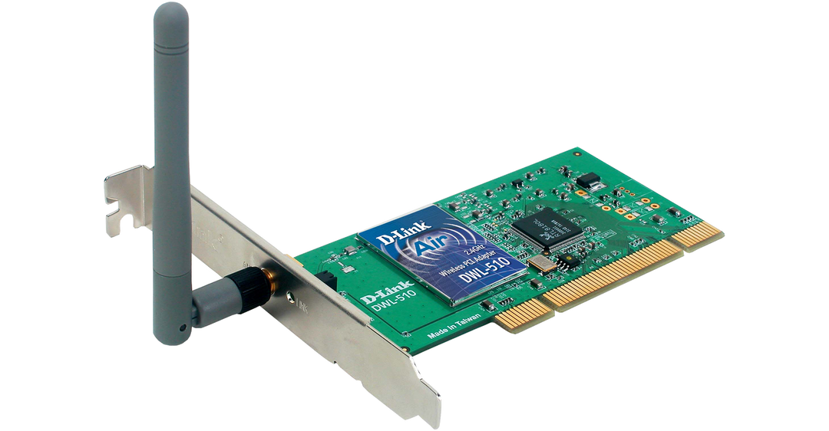

Can you name these items?
Notes:
PSU
GPU/Graphics card
SSD
Washing machine board
Blood fridge smart sensor

Slide 2

Digital Environments

Slide 3
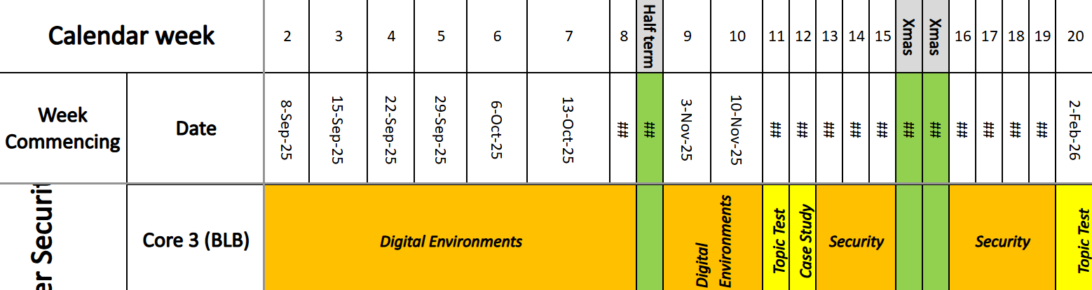
Content Overview

Slide 4
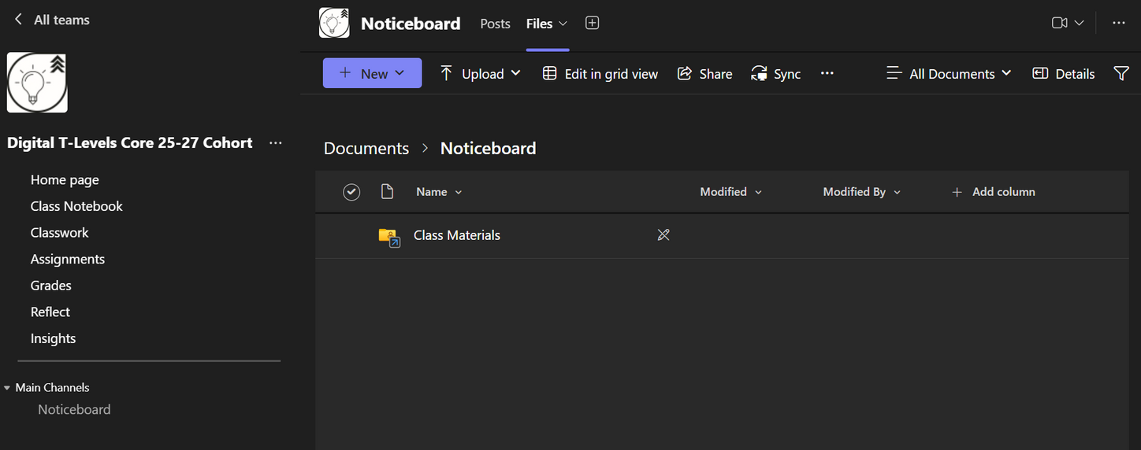
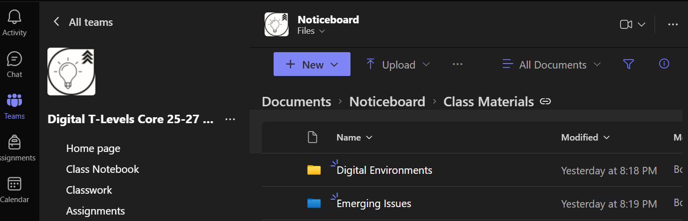
Accessing class powerpoints

Slide 5

Learning Objectives
Understand the features and use of different types of physical computers
Start to understand the features and use of different types of hardware devices

Slide 6
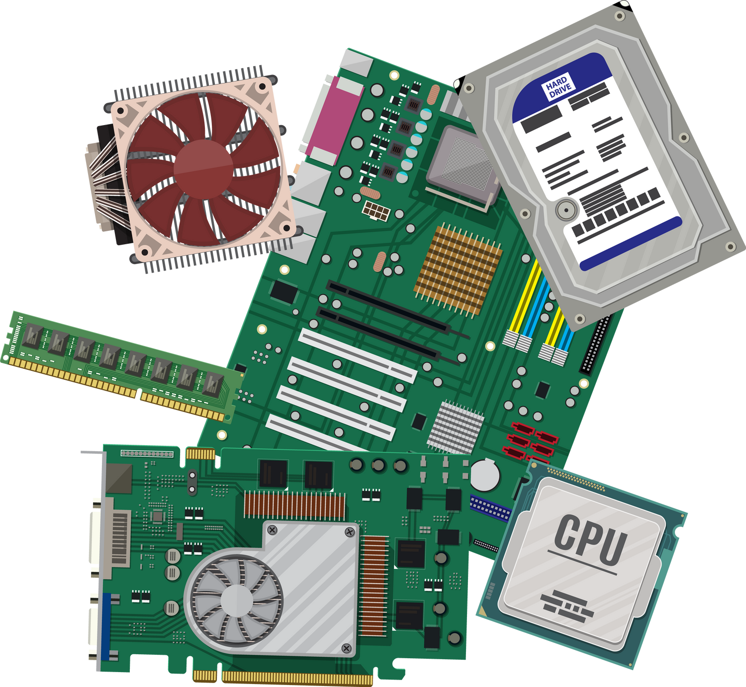
Hardware

Slide 7
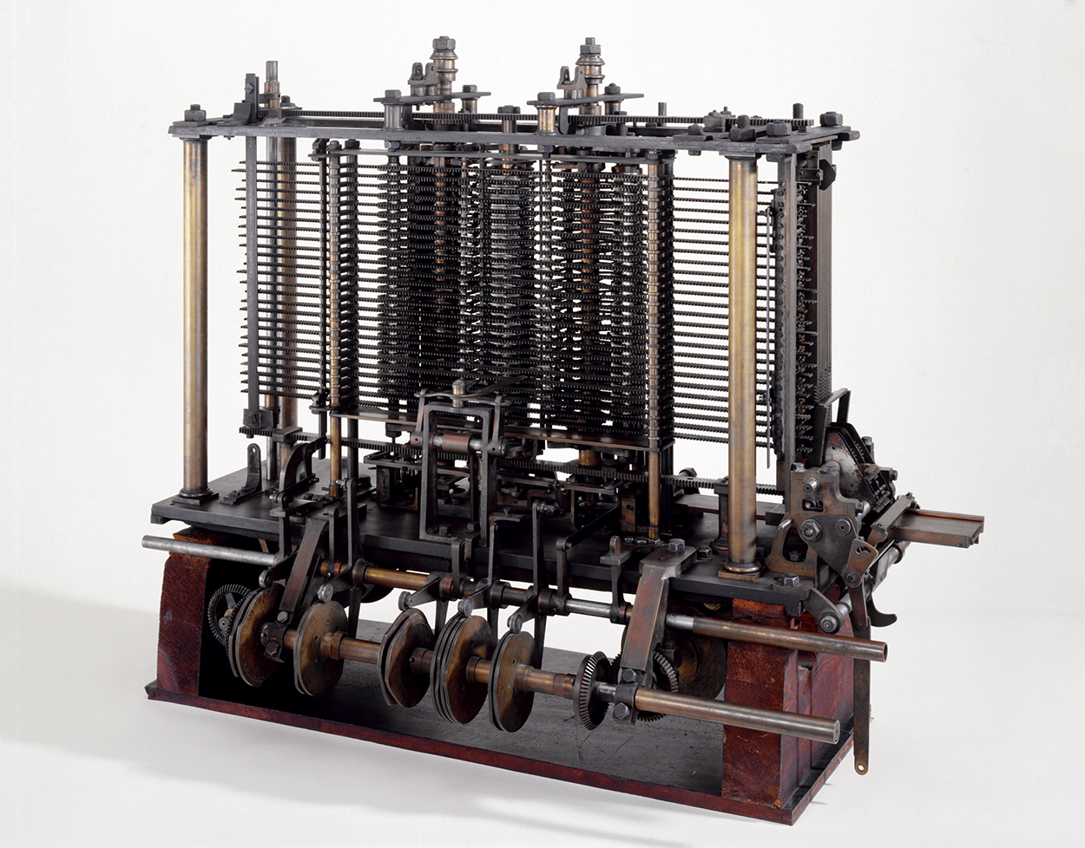
Notes:
The analytical engine was a proposed digital mechanical general-purpose computer designed by the English mathematician and computer pioneer Charles Babbage.[2][3] It was first described in 1837 as the successor to Babbage's difference engine, which was a design for a simpler mechanical calculator.[4]

Slide 8
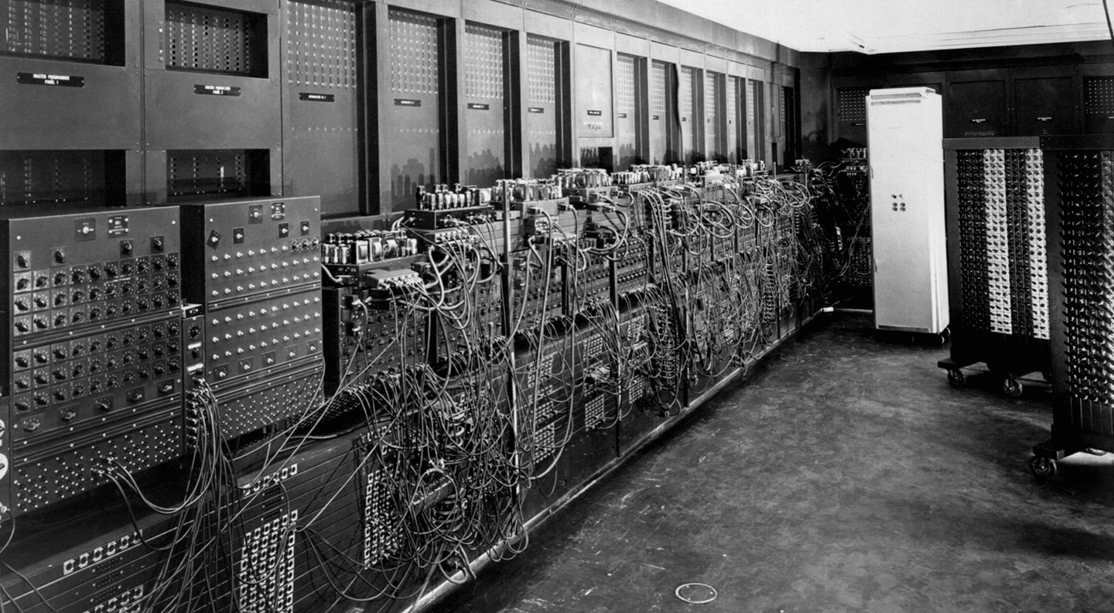
Notes:
The world’s first electronic digital computer, ENIAC (electronic numerical integrator and computer), was built for the U.S. Army between 1943-1945 and ushered in the Information Age. When it was refurbished then redeployed in 1946 it was the beginning of processes we follow in today’s IT asset disposition (ITAD) industry.

Slide 9
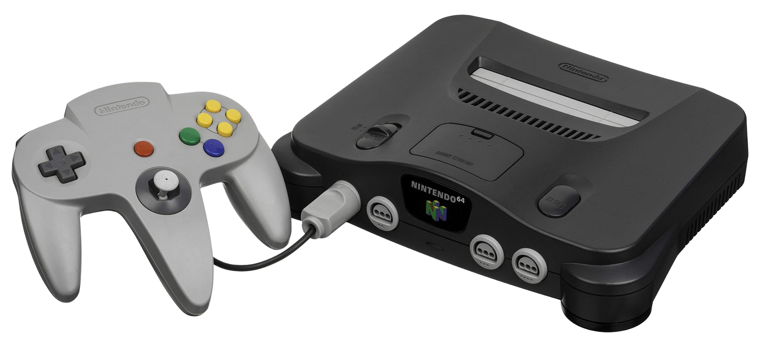
What was your first device?

Slide 10

Where do we see computers or computer systems in daily life?
Notes:
Discuss in groups or with the person next to you where you see computers in daily life and what types you might see (10 mins)

Slide 11

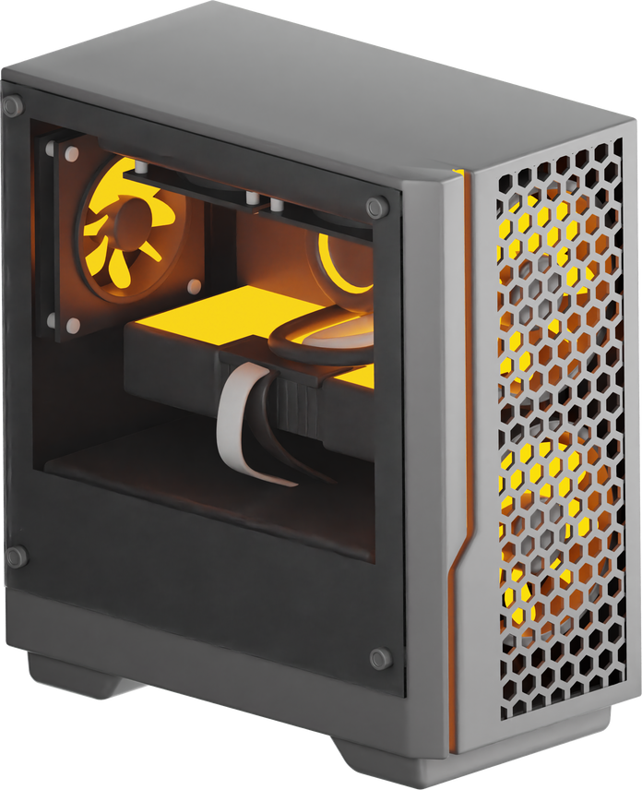
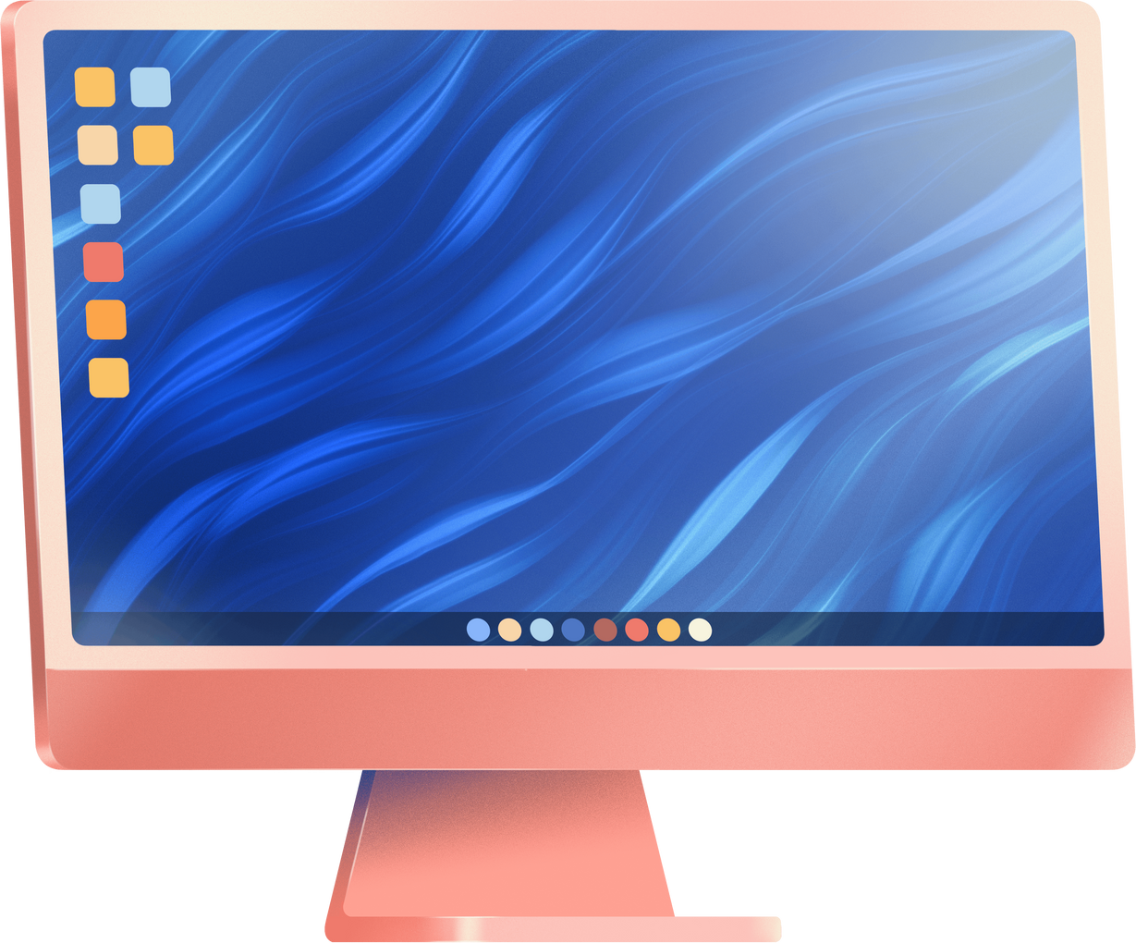
Personal Devices
Notes:
PC's/Laptops
Consists of a CPU containing the arithmetic logic and control circuitry on a single integrated circuit. Made up of CPU, RAM, ROM, HDD and various other devices.
Important to take into consideration physical size of computer i.e. all in one vs laptop vs desktop
Desktops can come in micro and mini form factor
Can come with wired/wireless network cards

Slide 12

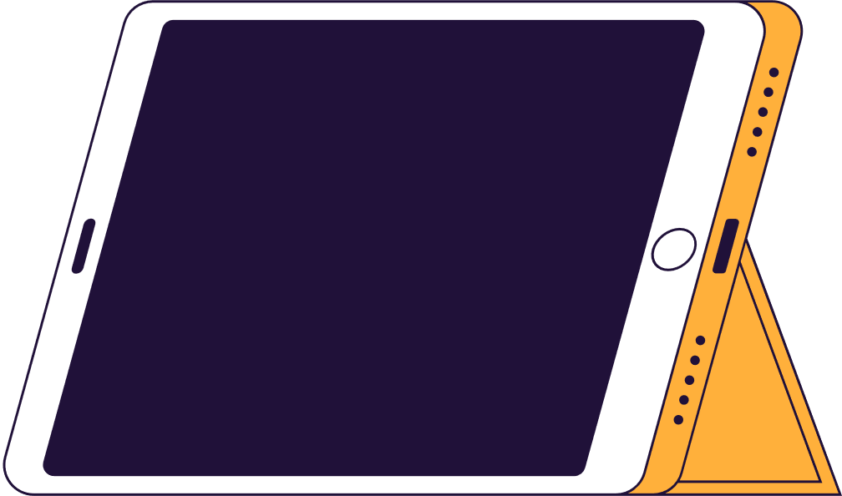
Mobile devices
Notes:
-Smartphones for personal/corporate use, offer portability and less restrictive than landline/VoIp.
-Tablets allow for portability, can be cheaper than laptops and allow people to work on the move. Also can be good for specific jobs such as graphic design
Often have
-rechargeable battery
-Cellular or Wi-fi access to the internet
-can connect to other devices via wi-fi or bluetooth
-small and lightweight
-Touchscreen or keyboard
-Can download data and information

Slide 13
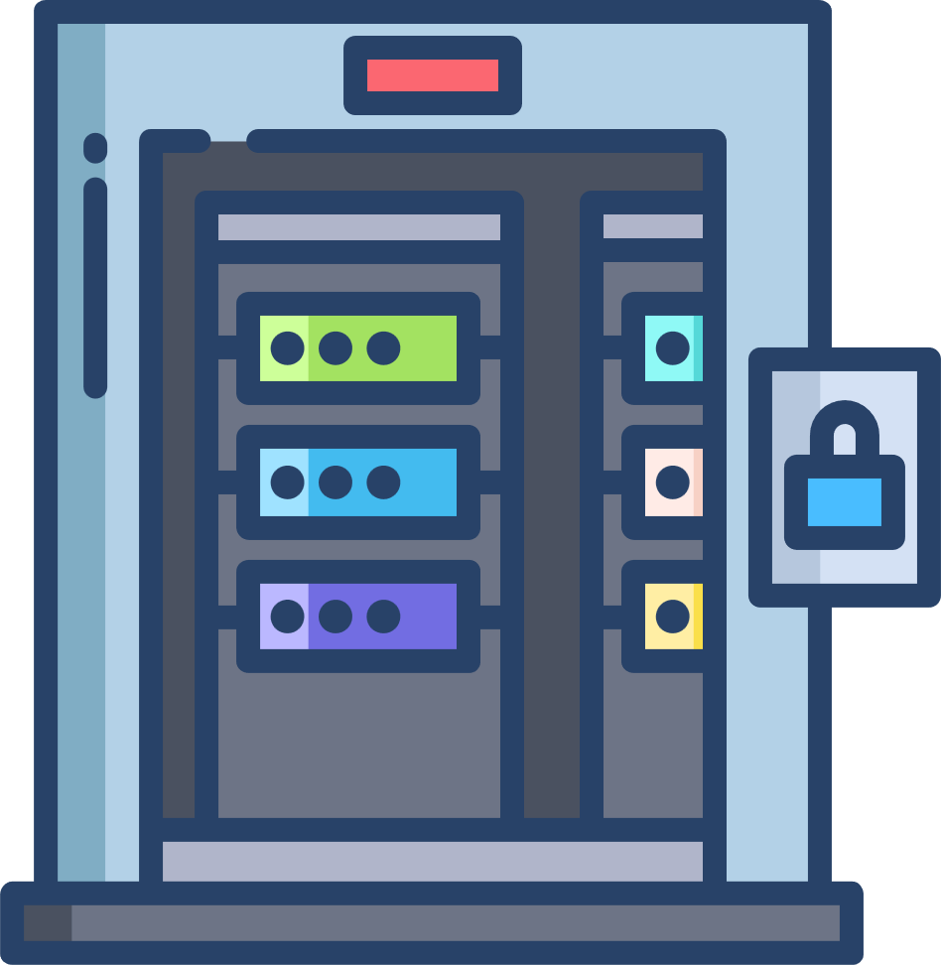
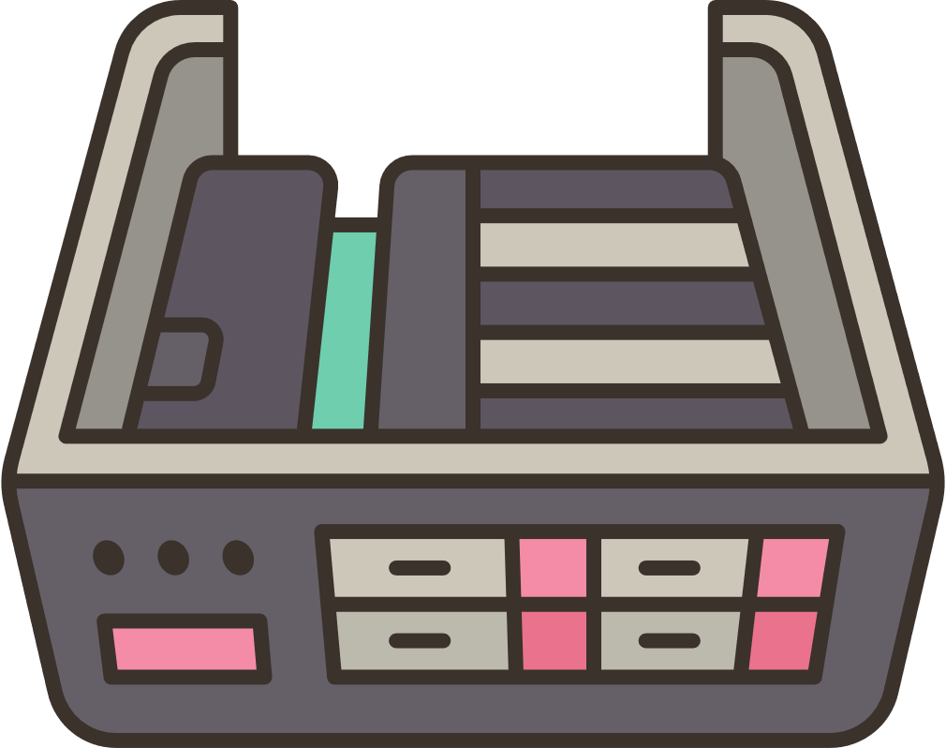

Servers
Notes:
-A server is a powerful computer that is set up to share resources, data, or services with other computers (called clients) over a network.
Clients connected send a message to the server request access to something or an application. The server then provides them with the data or resource requested
Servers can vary in cost, size etc. They can be more robust and reliable if they need to be on for long periods of time as opposed to a PC. Usually built for power
Can be rack mounted, blade type or even cloud computers

Slide 14

Server Types
Print
File
Web
Database
Mail
Application
Notes:
File server - for storing files centrally
Print server - for hosting printers centrally
Database- for hosting a database such as SQL
Web - for hosting a website
Mail - for hosting email services
Application - for hosting an application such as finance software like sage

Slide 15
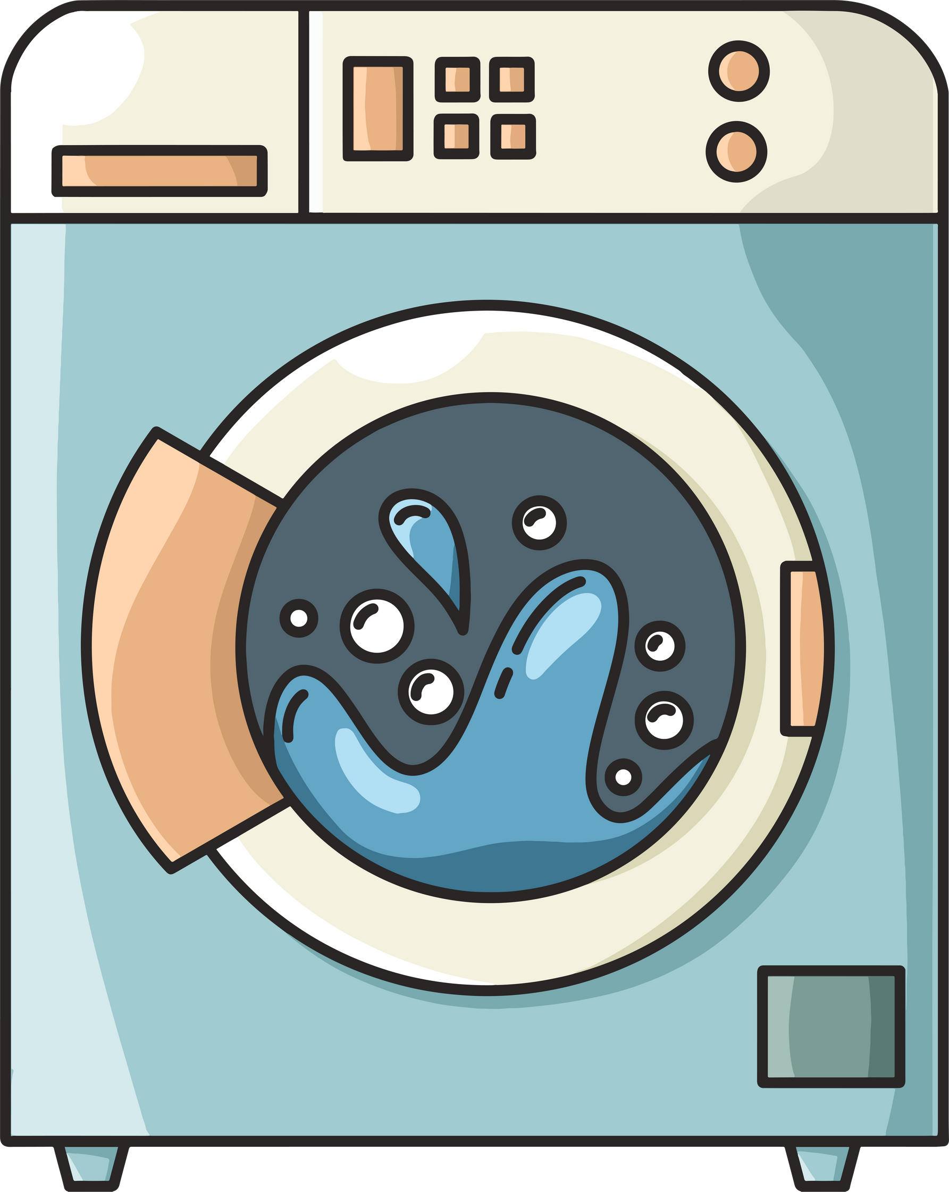
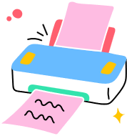

Embedded devices and IoT
Notes:
-Embedded devices are hidden computers inside something else that make it smart or automatic
For example, a washing machine, a heart monitor, and printer (pictures in slide)
There is crossover with IoT devices (internet of things) which can also talk to the internet
examples of IoT include
-connected applicances
-smart security systems
-wearable health monitors
-hand held inventory trackers
examples of embedded include
-industrial equipment like production line robots
-medical devices like patient monitors
-office equipment like routers and unmanaged switches

Slide 16
What sort of embedded devices or IOT might be in use?
Notes:
See answers on previous page

Slide 17


List the pros and cons of each type of device
Notes:
Some pros and cons listed in previous slides

Slide 18

Discussion
Notes:
10 minutes, and then bring back to the classroom

Slide 19

What makes up a PC?
Notes:
CPU
RAM
ROM
Motherboard
GPU
CMOS
Network cards
Storage like HDD, SSD
Case
Cooling system
Soundcard
Optical drive

Slide 20
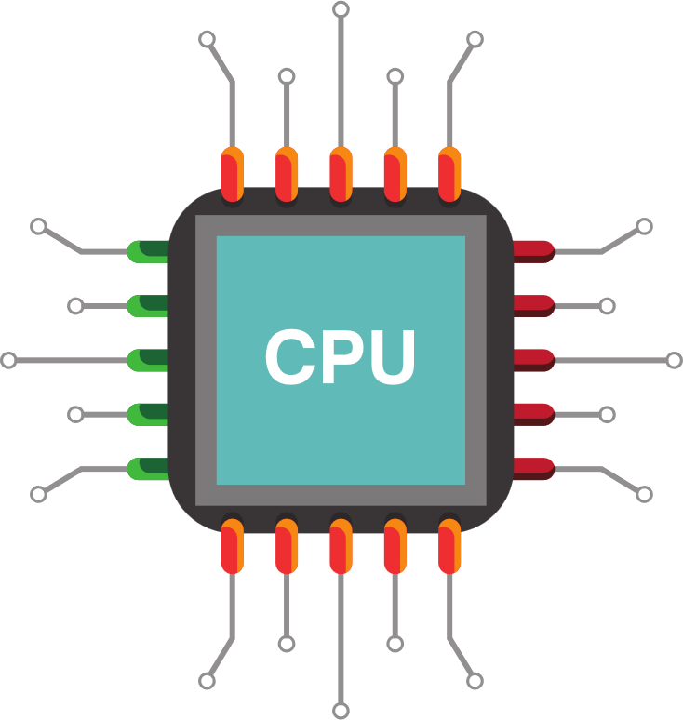
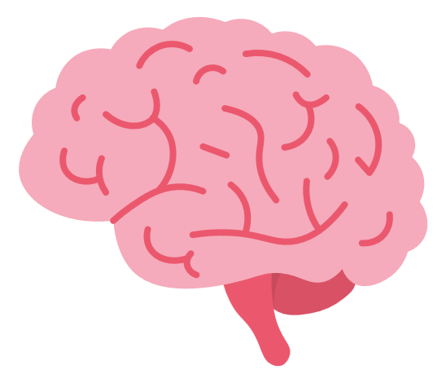
Processors
Essentially, the brain of a computer, server, or smaller device
Notes:
-Show of hands, has anyone ever overclocked their processor speed?
PUs contain a clock - everytime the clock ticks an instruction is carried out
-Clock speed is like how fast a runner can run laps. Faster clock speed means faster speed at carrying out instructions

Slide 21
Processors
Fetch
Decode
Execute
Notes:
Happens a billion times per second
Fetch – The chef takes an ingredient (instruction) from the fridge (RAM).
Decode – The chef reads the recipe step to see what needs to be done.
Execute – The chef cooks the food (does the work).

Slide 22
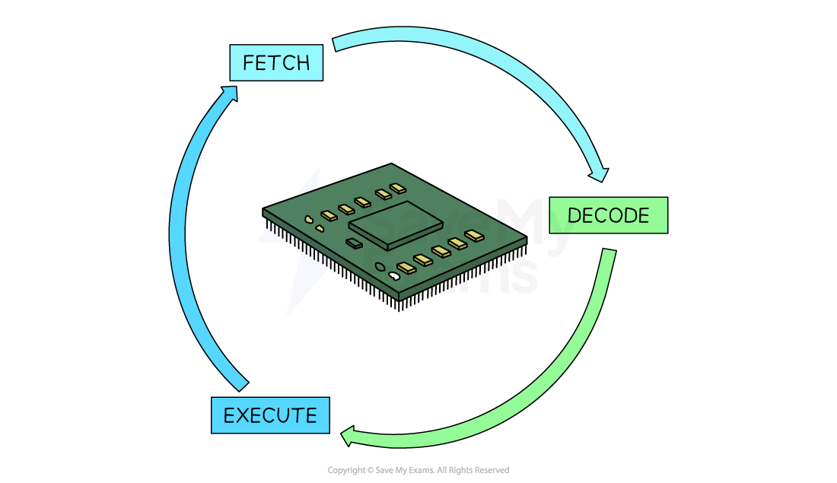
Processors

Slide 23
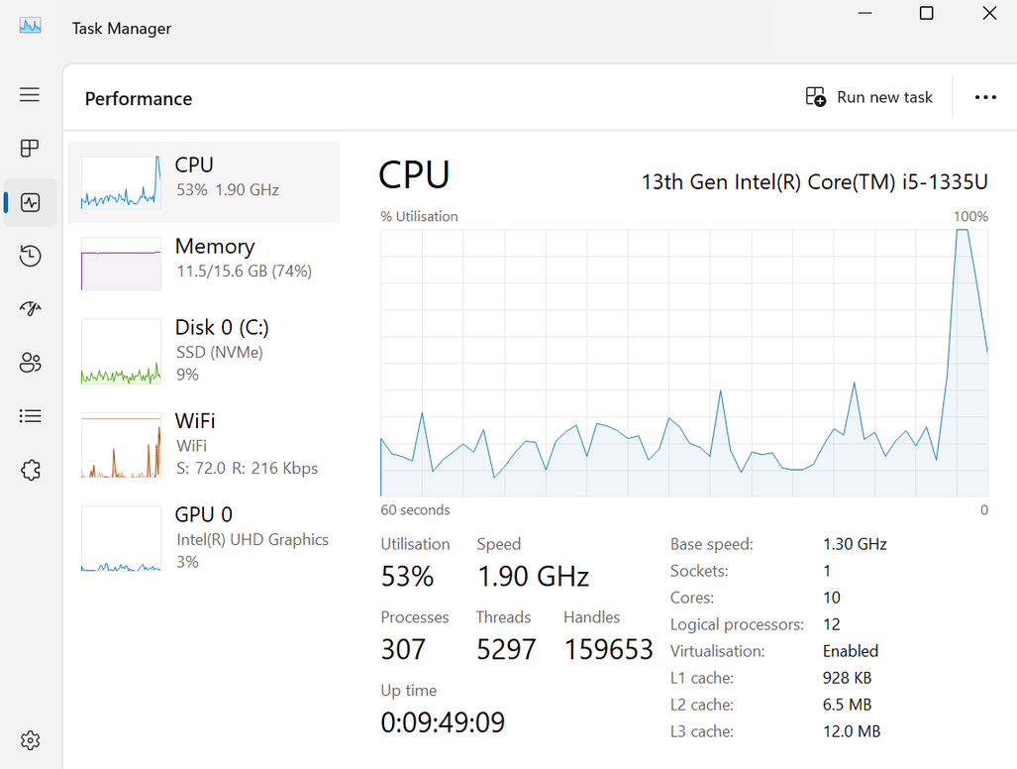
Go to task manager on your PC
Notes:
-Core is a mini CPU inside the processor. More cores = more speed i.e. dual core, 2 tasks at once
-Clock speed is like how fast a runner can run laps. Faster clock speed means faster speed at carrying out instructions
-Cache size is very small and fast memory built into PCU that remembers frequently used instructions
-Logical processor - if a processor has 4 cores it might split it to 8 to get more out of it. Hyperthreading used to split existing cores.
(10 minutes)

Slide 24
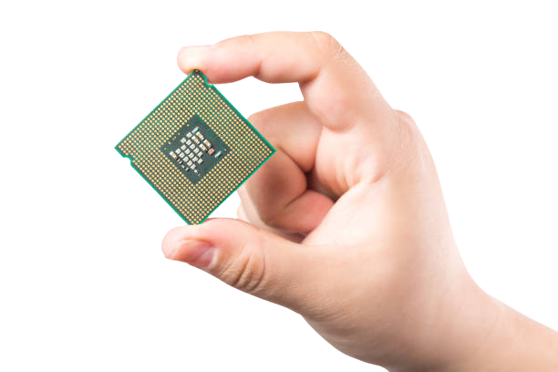
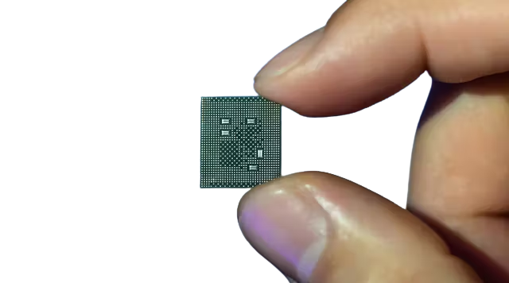
Mobile Processor vs PC processor
Notes:
A mobile processor prioritizes energy efficiency, heat management, and battery life for portable devices like smartphones and laptops, using lower voltages and more sleep modes.
A normal (desktop) processor focuses on maximum performance for desktop PCs, offering higher clock speeds, more cores, and better cache, but consuming significantly more power and generating more heat.

Slide 25
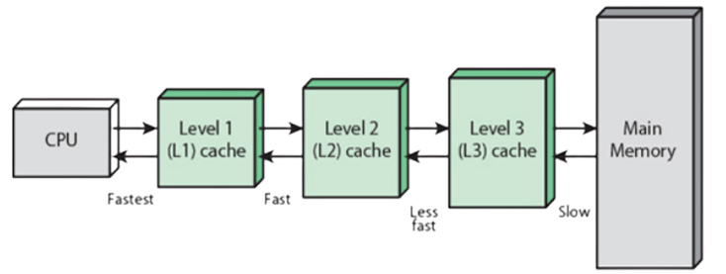
3 levels of processor cache
Notes:
Cache is like a filing cabinet
Level 1 is like the top draw of your desk, you store pens and notebooks in here
Level 2 is things you need infrequently, like your stapler or calculator
Level 3 is your spare paper or folders (instead of going to filing cabinet, RAM)
More cache = more speed and performance

Slide 26
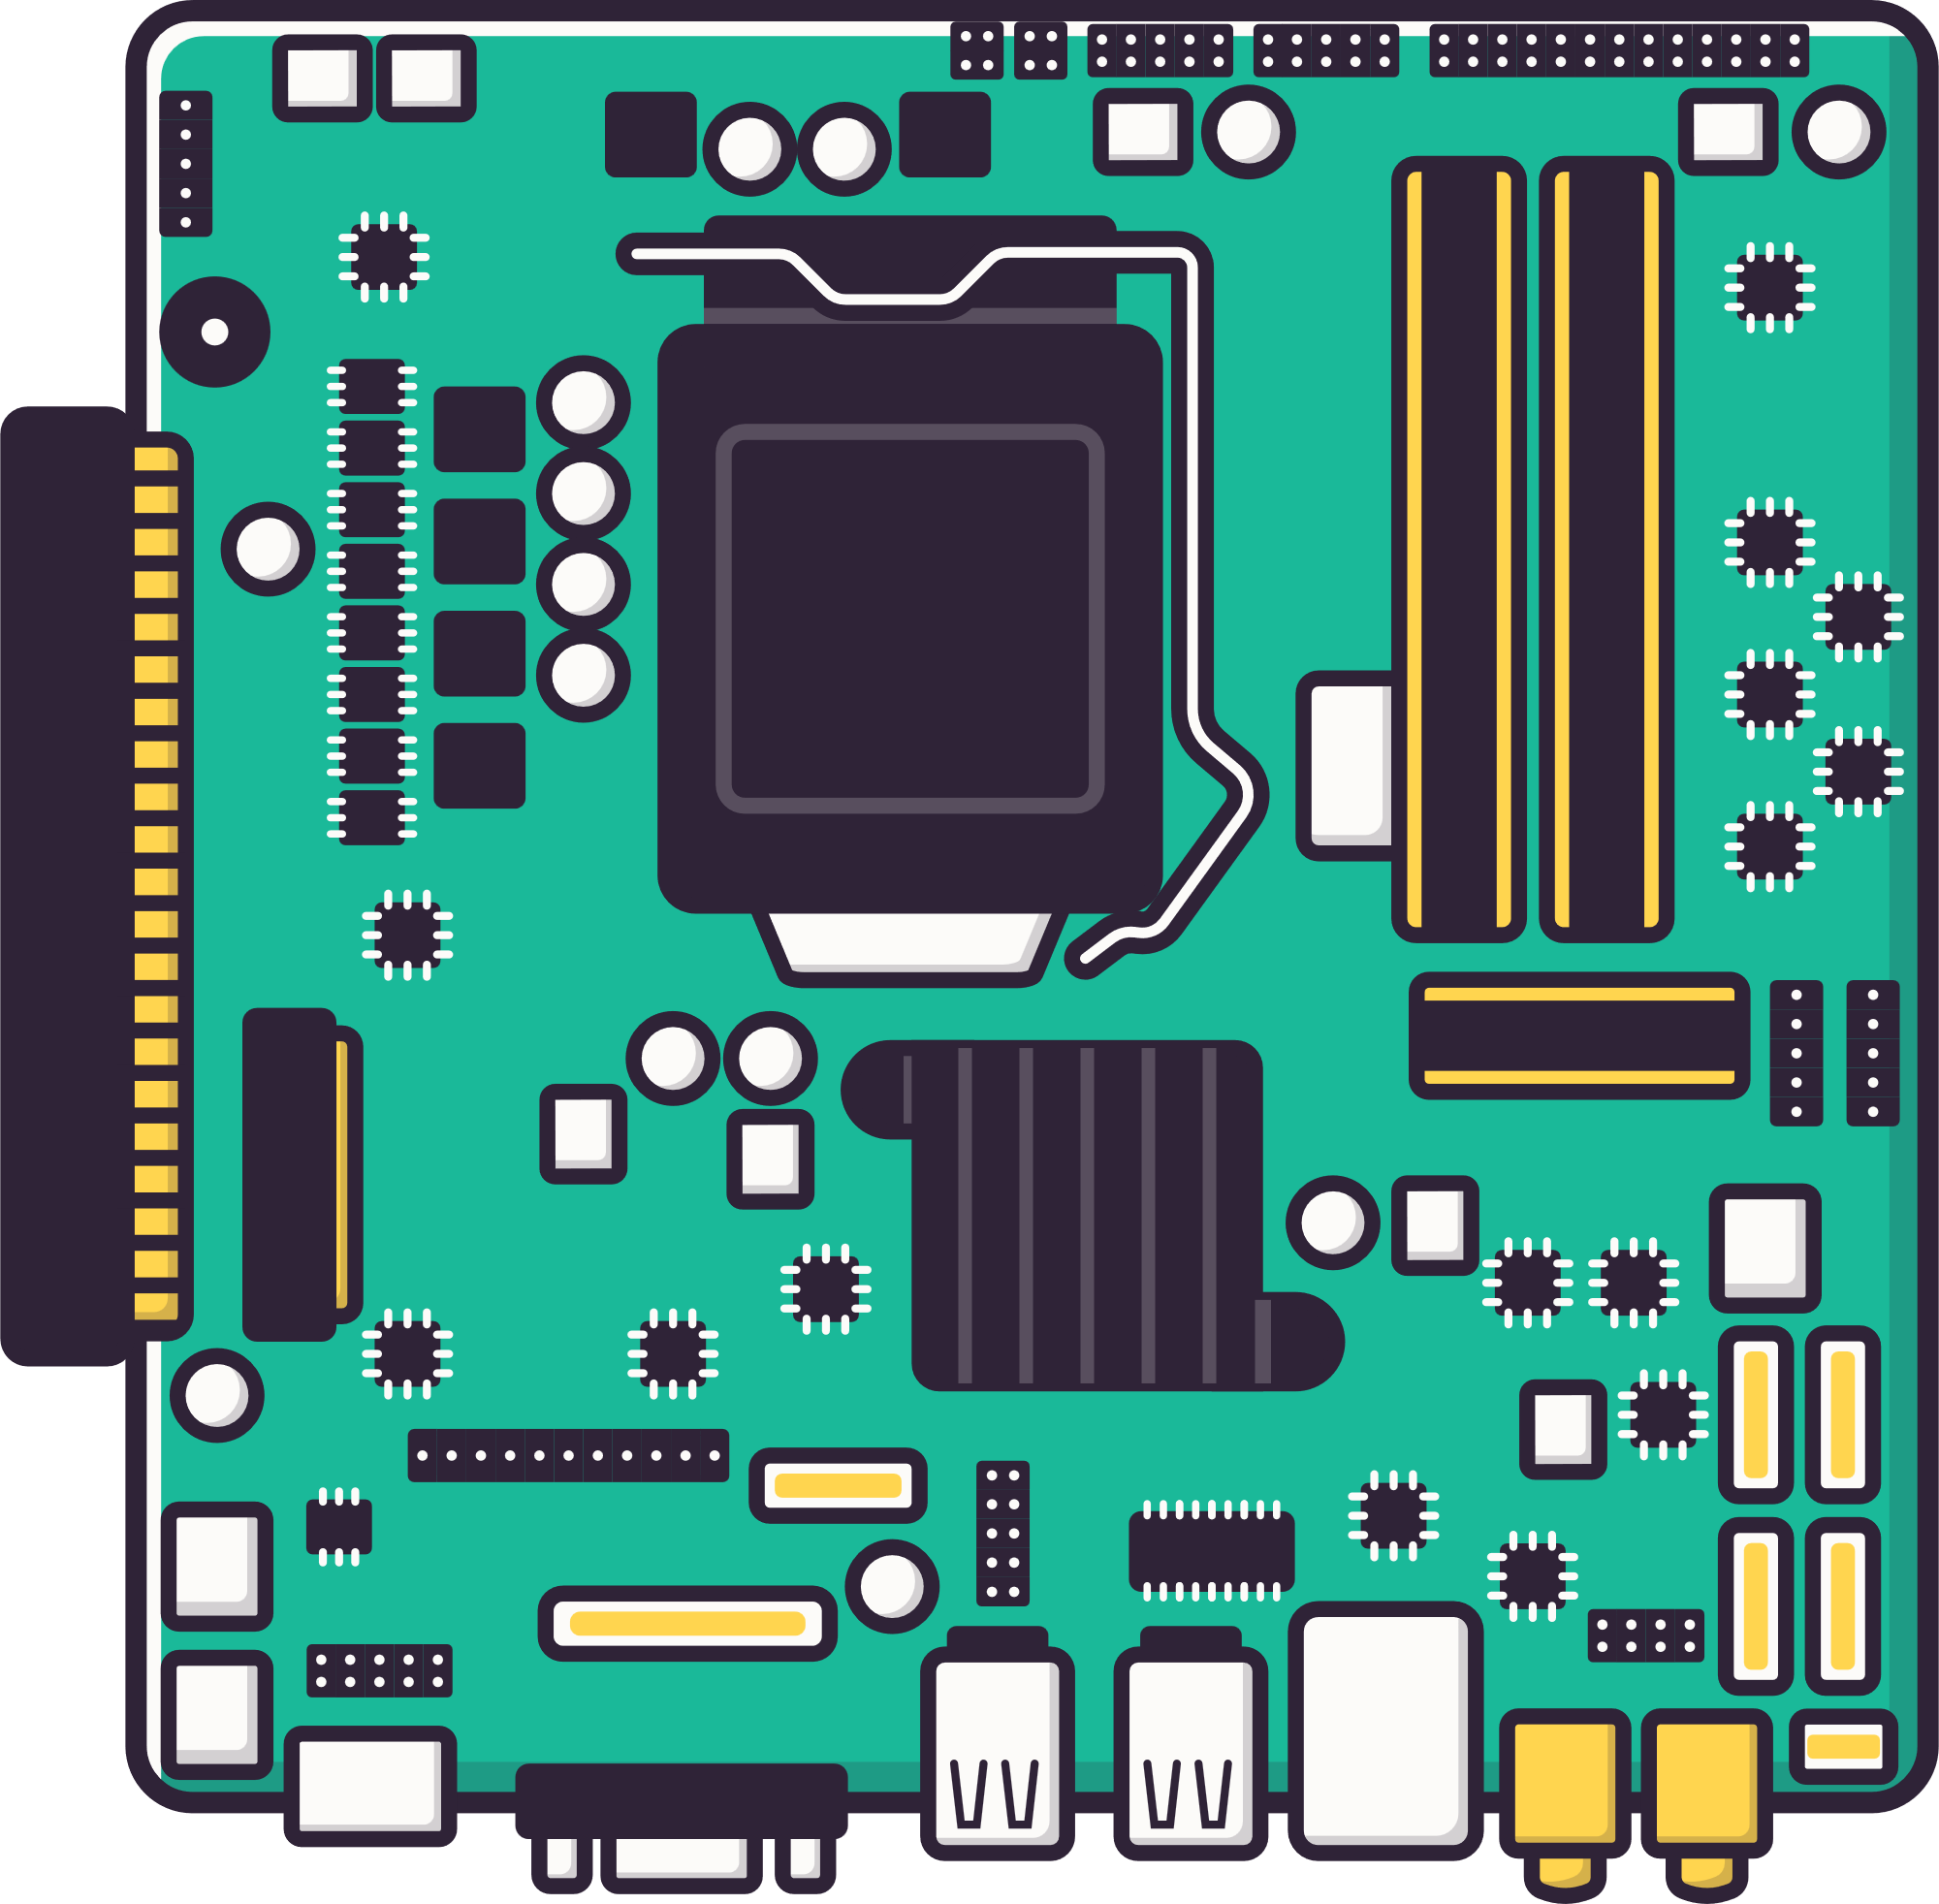

Motherboards
Connects everything together, like a central nervous system
Notes:
Why it’s important:
It decides what parts you can use (e.g., type of CPU and RAM).
It makes sure components can communicate
It allows upgrades, like adding more memory or a graphics card.

Slide 27
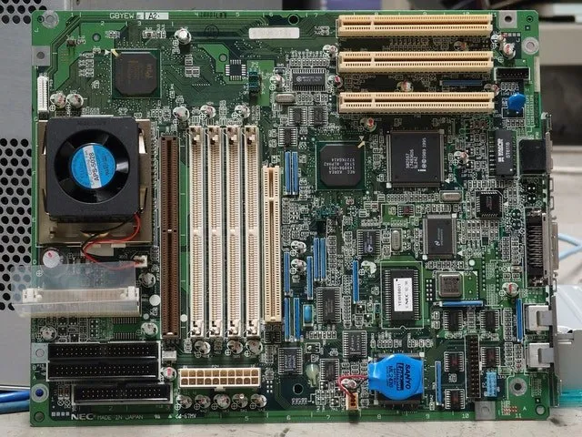

Slide 28
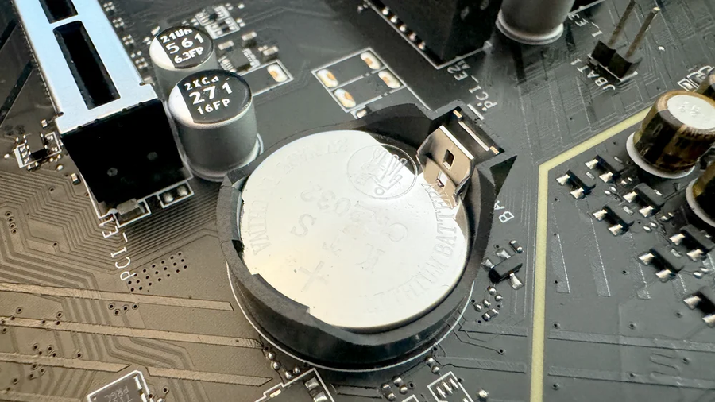
CMOS
Complementary Metal-Oxide-Semiconductor
Notes:
A small chip on the motherboard that stores critical BIOS settings, like the date, time, and hardware configurations, using a CR2032 battery to maintain power and data when the computer is off.
When the CMOS battery fails, settings are lost, leading to issues like incorrect system time or boot problems, and resetting the CMOS can restore the system to its default configuration

Slide 29

Ram
Random Access Memory
A computer’s short-term memory (Volatile)
Notes:
Speed – Much faster than permanent storage (like SSDs), so it helps the CPU work quickly.
Capacity – The amount of RAM (e.g., 8GB, 16GB, 32GB) affects how many tasks or programs can run smoothly at once.
Slots – Installed into the DIMM slots on the motherboard.
Dual Channel: allows you to read/write data at the same time provided RAM matches (2 streams instead of 1)
When a PC is turned off, RAM loses instructions/data
Data stored electrically
Can be expensive
Provides more Power
Can be easily changed
Measured in GB's (usually) i.e, 16 GB, 32GB
Forgets instructions when PC turned off (Volatile)

Slide 30
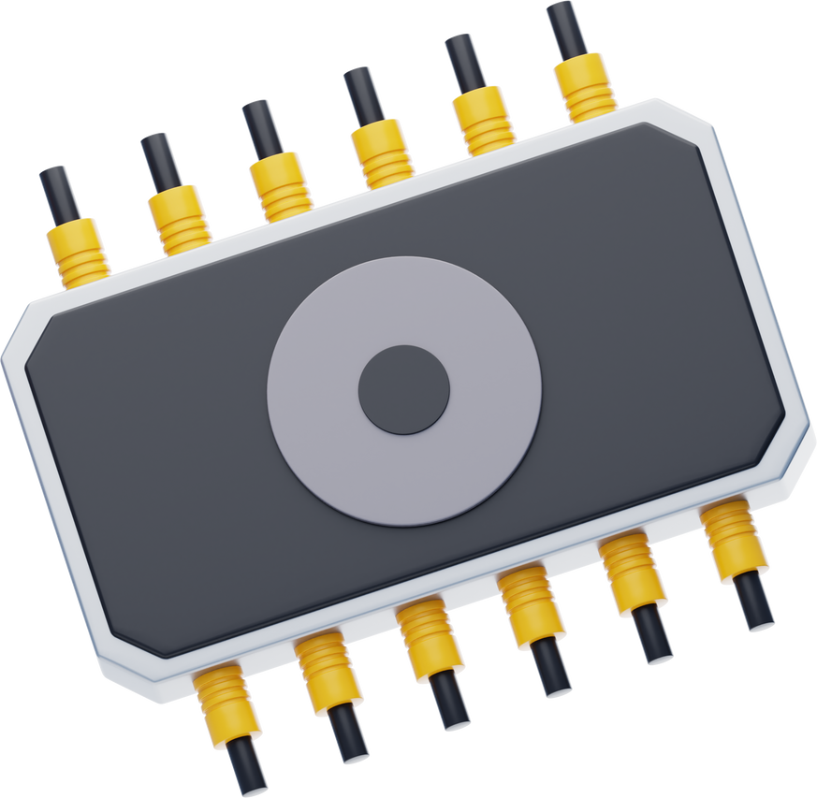
Rom
Read Only Memory
Stores permanent firmware and data that can’t be changed, i,e. BIOS
Notes:
ROM- Stores permanent data and firmware that can't be changed. Usually firmware instructions, essentially a start up manual for the PC.
Stores the firmware/BIOS (or UEFI) – the basic startup instructions that tell the computer how to begin running.
Without ROM, the computer wouldn’t know how to load the operating system.
Ensures that the system can always start, even if the hard drive is empty.
Like a recipe book - recipes are there and you can read them when you want, but it's hard to change them
-Doesnt depend on electric current
-Data written to cells using binary
-Faster than secondary memory
(remembers instructions when turned off)

Slide 31
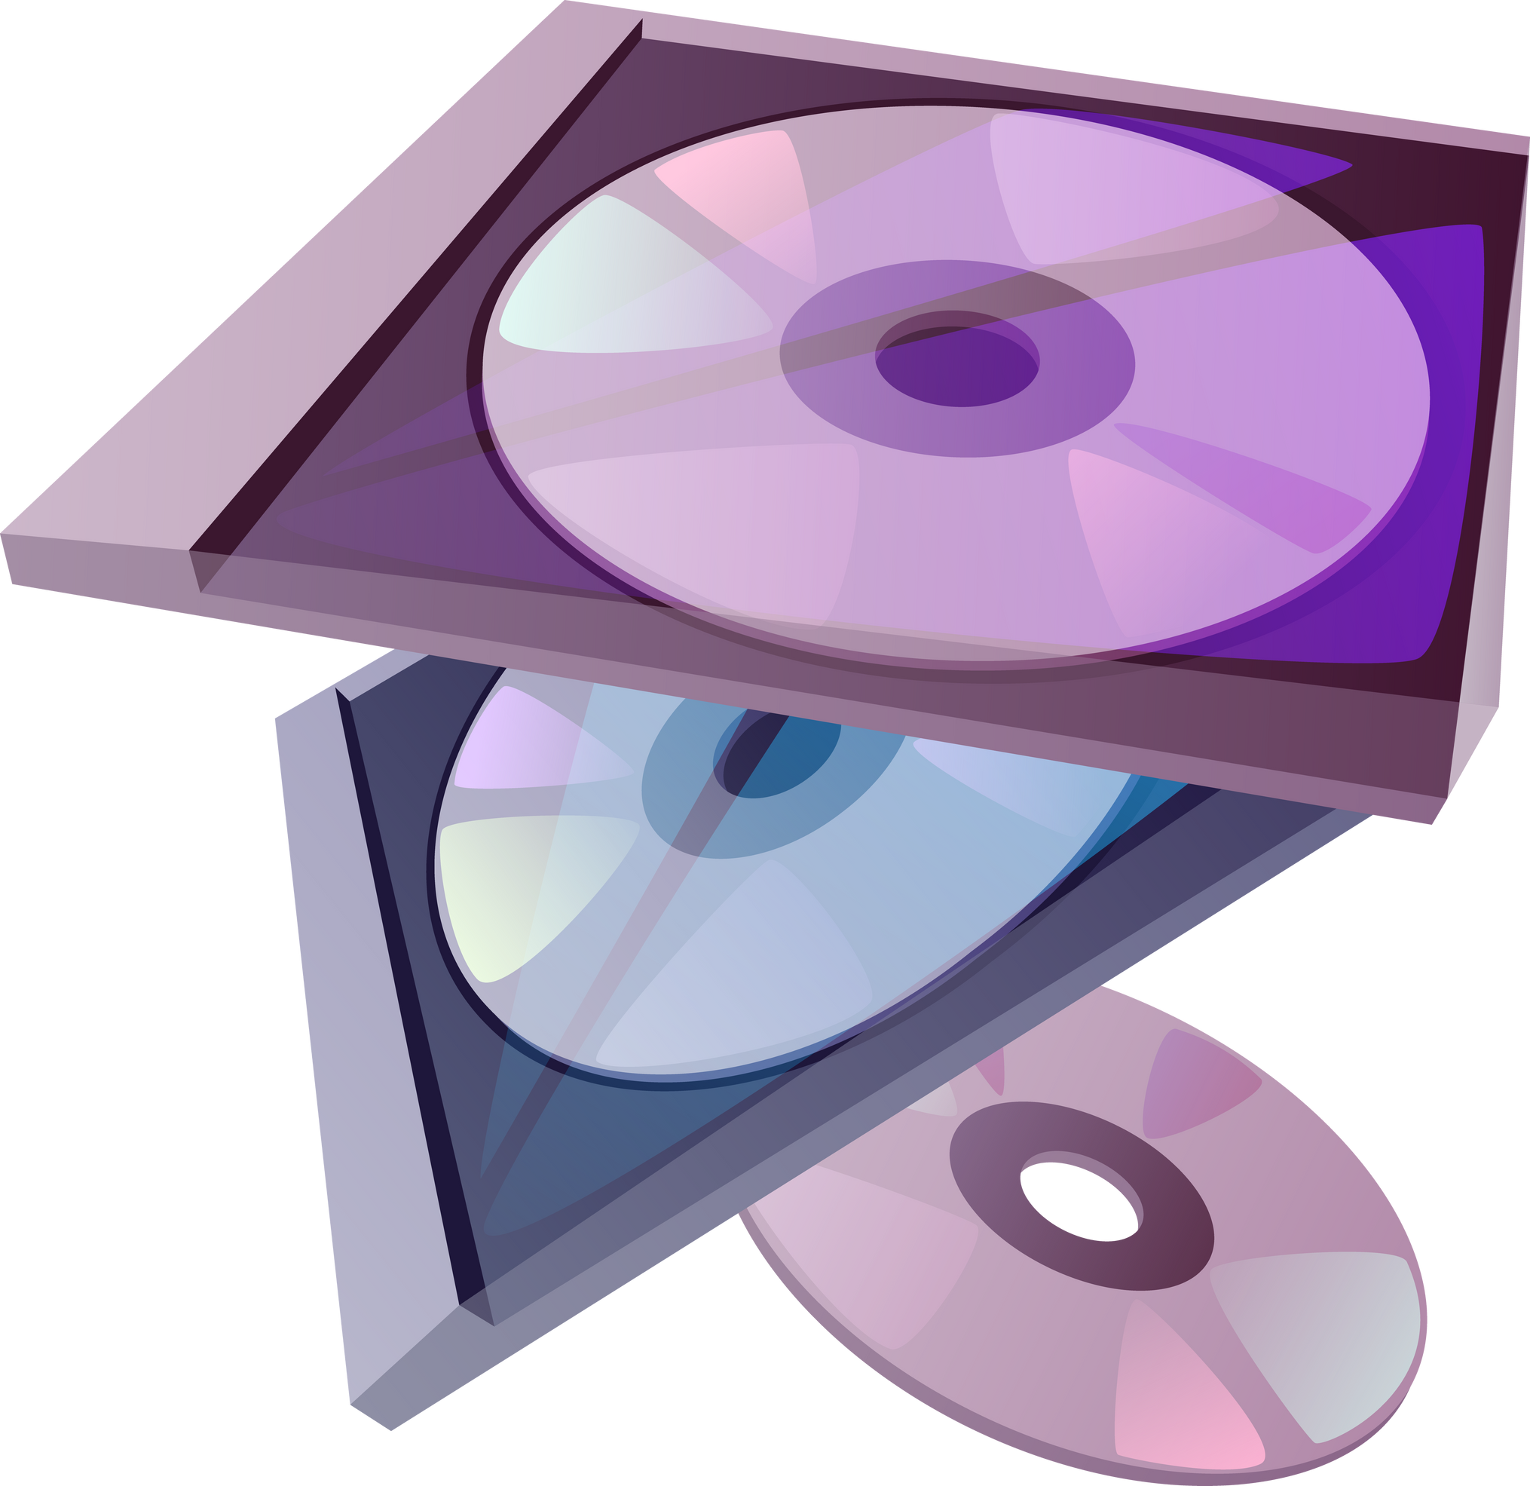
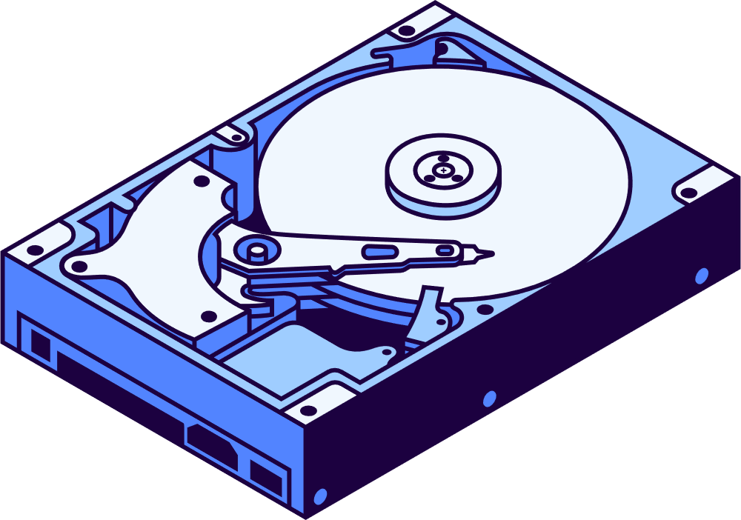
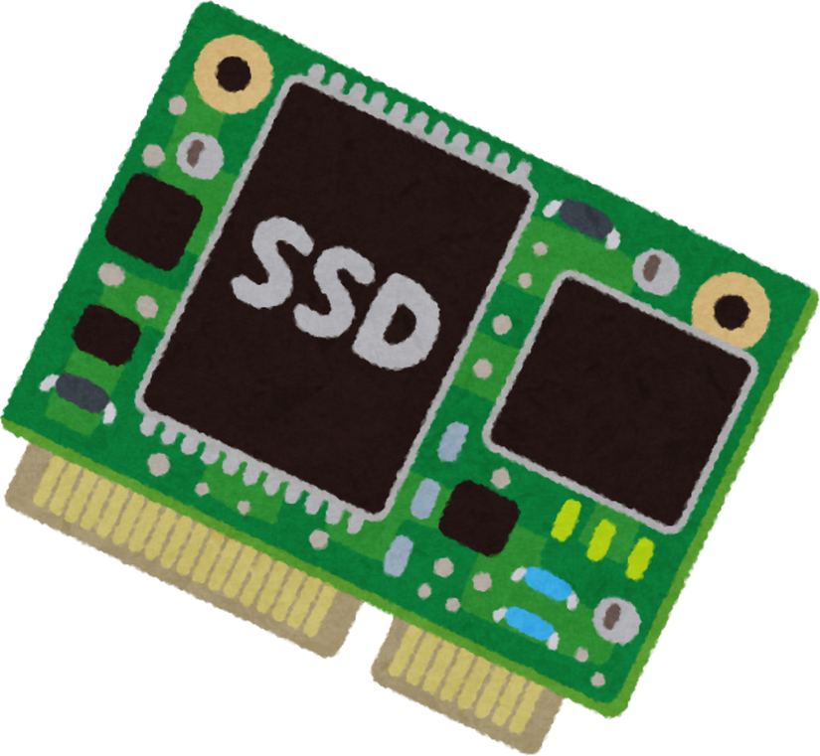
Secondary storage types
Magnetic
Optical
Solid State
Notes:
Magnetic - Magnetic storage devices use magnets to record digital information on a magnetic medium, with common examples including hard disk drives (HDDs), magnetic tapes, and floppy disks.
Solid State - A solid-state drive (SSD) is a data storage device that uses semiconductor flash memory chips instead of the traditional spinning magnetic disks and mechanical read/write heads found in hard disk drives (HDDs) (no moving parts)
Optical - Optical storage is a data storage method that uses lasers to read and write information onto a disc. Data is encoded allowing for the storage of digital data on media like CDs, DVDs, and Blu-ray discs.

Slide 32
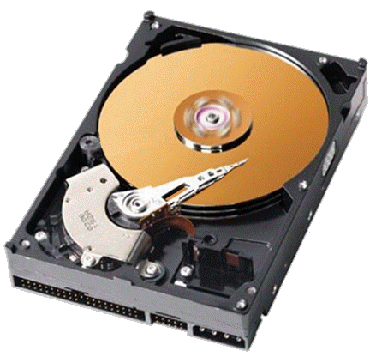
Hard Disk Drive
Notes:
Magnetic - Magnetic storage devices use magnets to record digital information on a magnetic medium, with common examples including hard disk drives (HDDs), magnetic tapes, and floppy disks.
Cost effective and used where speed is less critical
Vunerable to physical damage from drops or impacts, environmental factors like extreme heat or dust, electrical issues such as power surges or fluctuations, and wear and tear from prolonged use over time

Slide 33
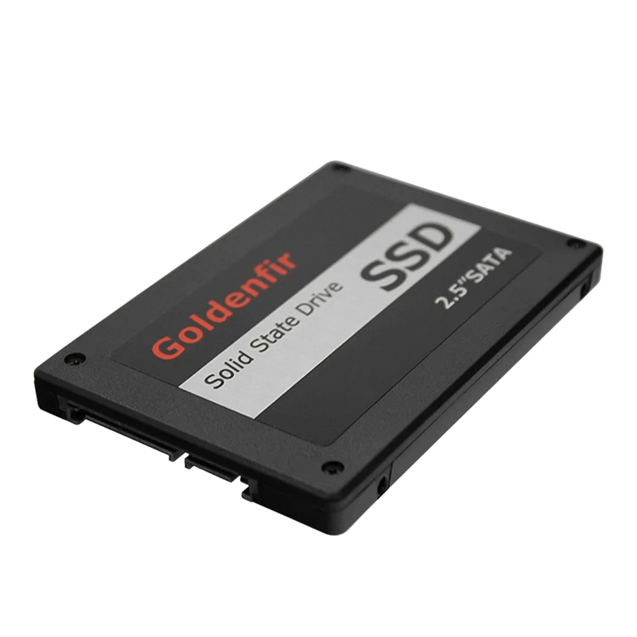
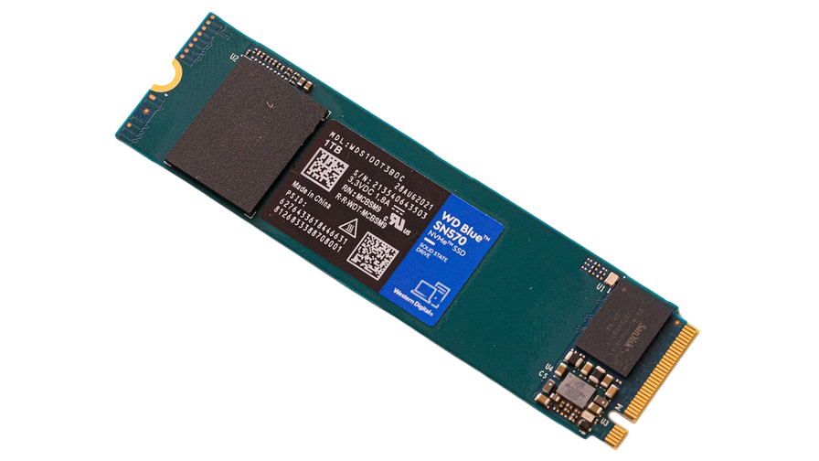
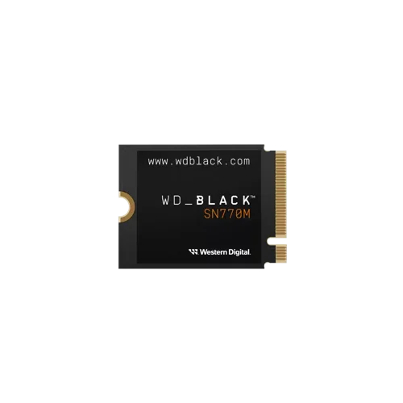
Solid State Drive
Notes:
SSD's use flash memory chips to store data
Fast – Much quicker at reading and writing data than HDDs.
Reliable – No moving parts, so they are less likely to break if dropped or knocked.
Silent – No spinning disks or moving heads, so they make no noise.
Lightweight – Smaller and lighter than HDDs.
SSD's are like a bookshelf of flashcards instead of a filing cabinet with drawers (HDD)

Slide 34
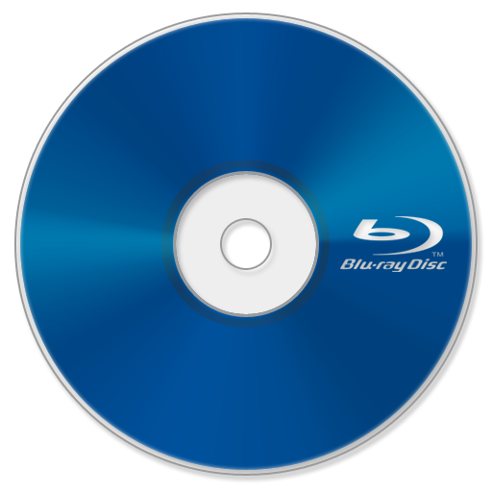

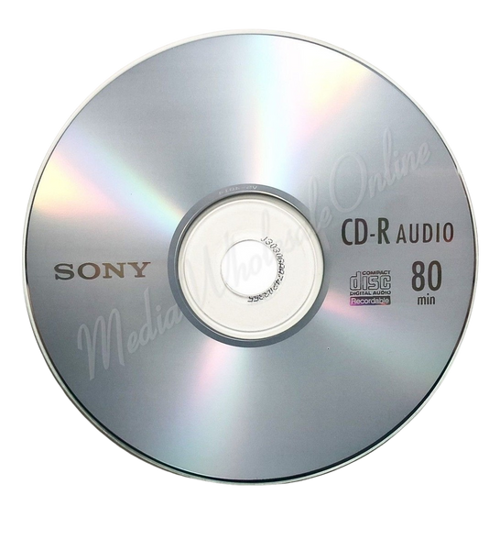
Optical
Notes:
Data is stored on the disc as tiny pits and lands on the surface.
A laser beam shines on the disc, and the reflection is read by the optical drive.
Portable – Easy to carry and share.
Cheap – Discs are inexpensive.
Durable – If handled carefully, they can last many years.
Low capacity – Much smaller storage compared to SSDs or HDDs.
Slower – Reading/writing is slower than modern storage devices

Slide 35
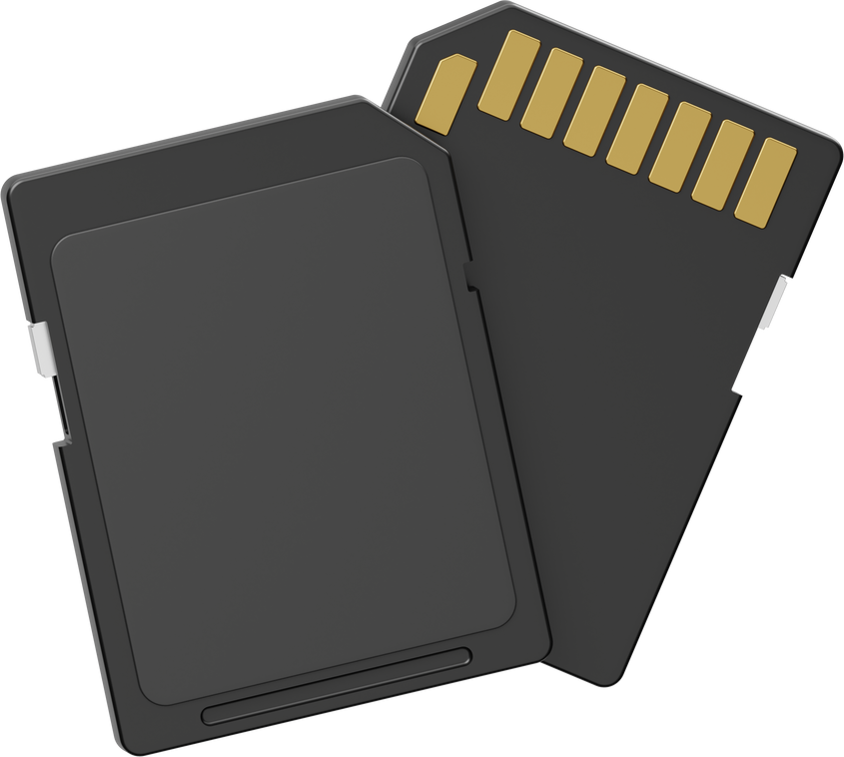
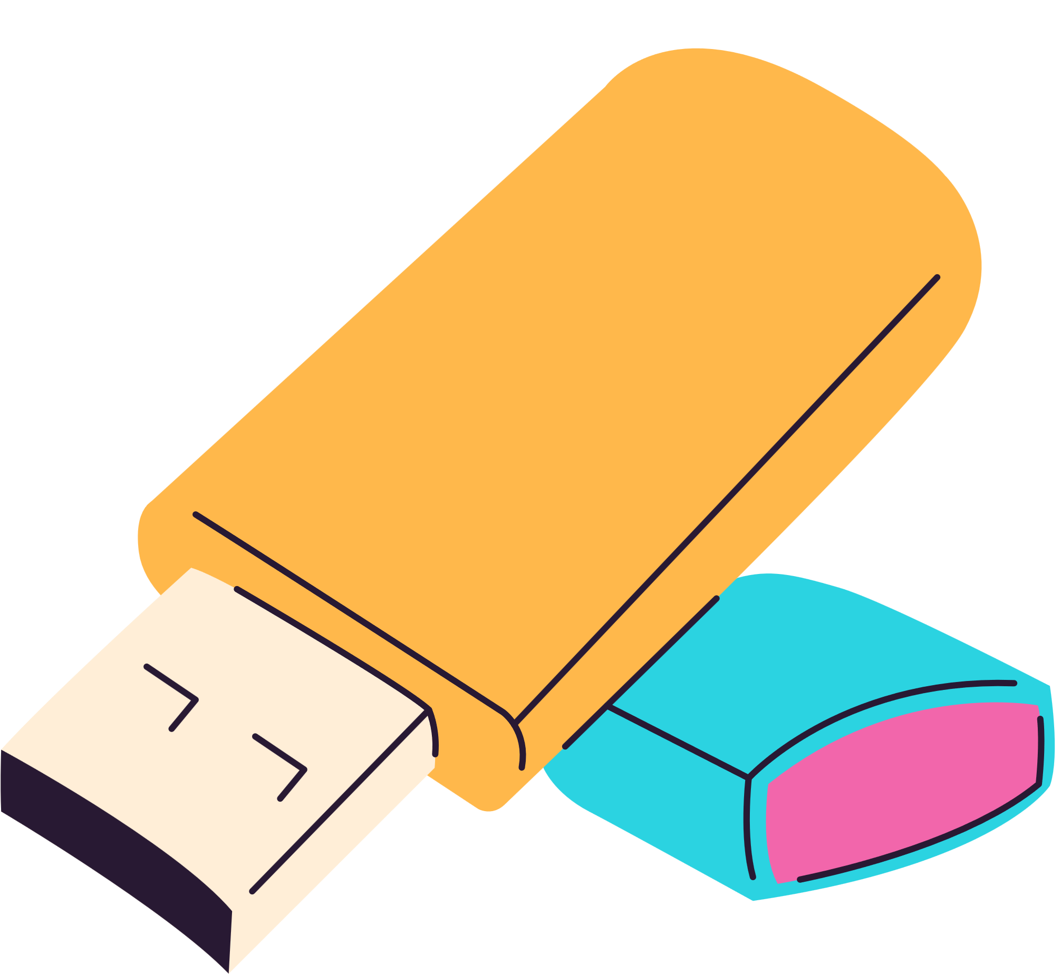
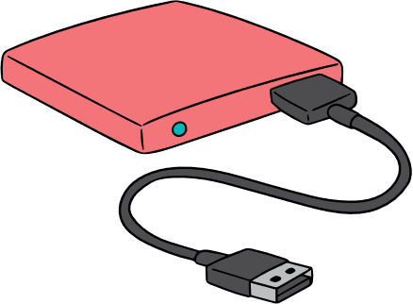
Other
Notes:
USB Stick
External Hard Drive
SSD

Slide 36
Storage
A university provides lecture recordings and learning resources to students in remote areas. They need a cheap way to distribute the material that doesn’t require internet access
A graphic designer uses design software that needs fast access to large project files. They need storage that makes the computer run quickly and reliably, even when moving between offices.
A small business needs to back up years of customer records and project files. They want lots of storage space at a low cost, but don’t mind if access is slower.
Notes:
What storage is suitable for each scenario?

Slide 37
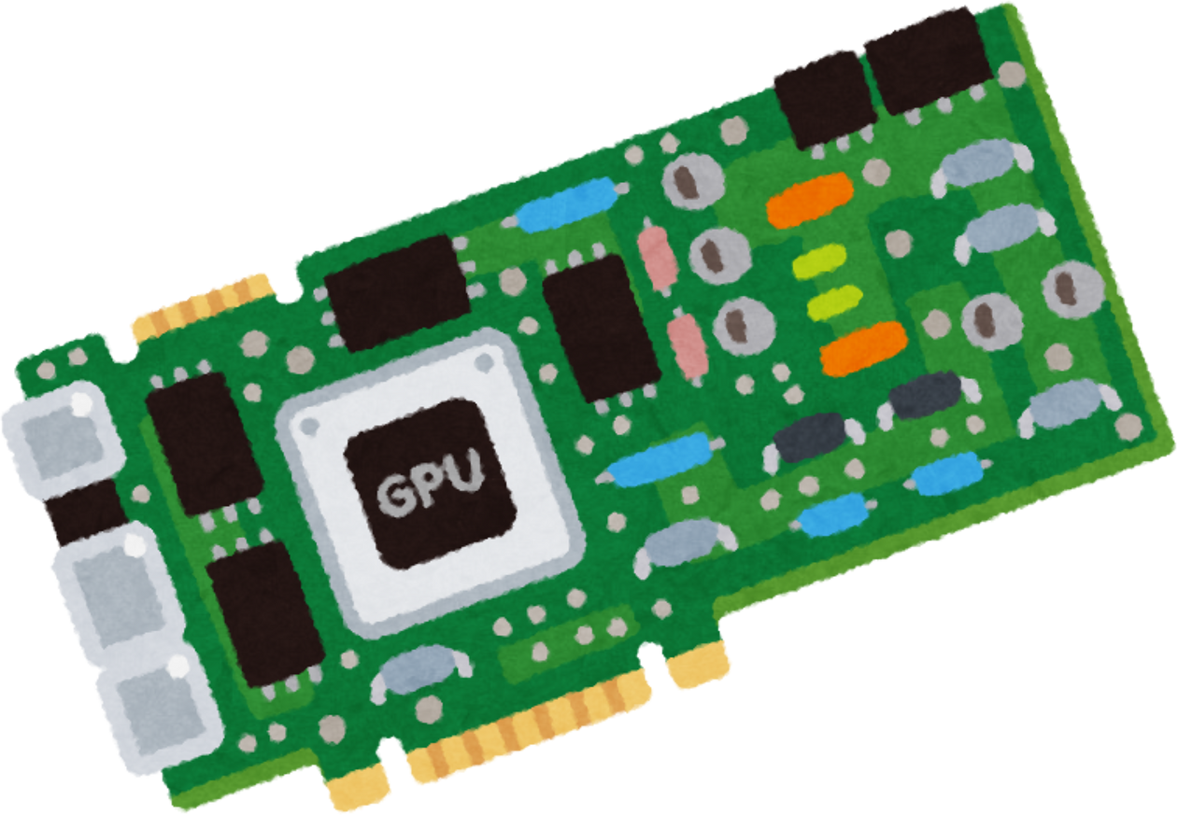
Graphics Processing Units
Notes:
Graphics card is a special processor designed to handle graphics and parallel tasks very quickly. It’s what makes images, videos, and games run smoothly on your screen.
VRAM (Video RAM):
The dedicated memory inside the GPU used to store textures, images, and frame data. It’s like the GPU’s workspace — the more VRAM, the more (and larger) graphics it can handle at once.
Dedicated graphics can be more expensive but also take the load off of other components within a PC. Allows fast performance

Slide 38
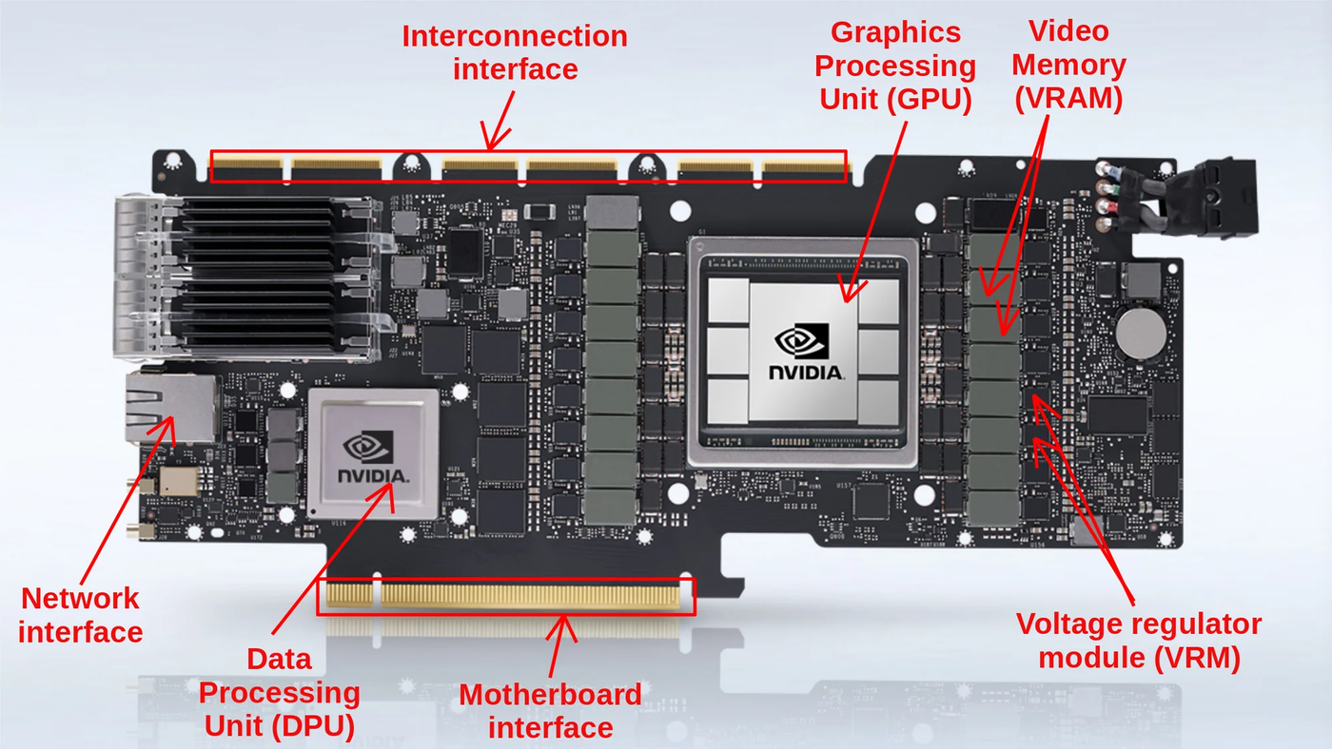
Dedicated Graphics
Notes:
See notes in previous slide

Slide 39
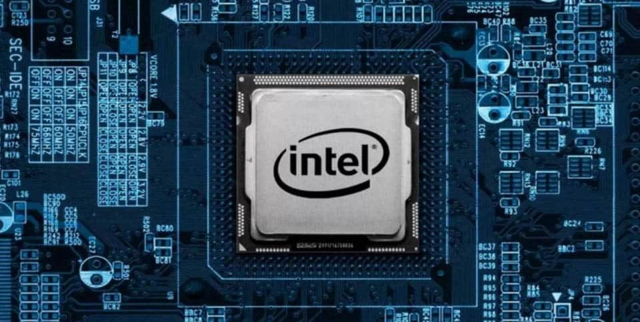
Integrated graphics
Integrated graphics are usually integrated with the CPU or motherboard and share RAM
Notes:
Integrated graphics are usually integrated with the cpu or motherboard and share RAM.
This can be a cost effective way of getting graphics. They also save space, can be more energy efficient and can be more affordable.
Drawback is graphics performance, can't upgrade

Slide 40

Who might use different types of graphics cards?
Notes:
Integrated graphics examples: office workers, students, light PC users
Dedicated GPU examples: Gamers, CAD engineers, video editors, AI engineers

Slide 41

Questions
Notes:
Stretch: Which components could you over spec now to save costs later?
What component is likely to be the bottle neck in your system?
Could you improve one component without introducing a cost?

Slide 42

Break
Notes:
30 mins

Slide 43


Device Specs Activity
Individually, look at the spec sheets of the devices provided around the room, and fill out part 1 of your worksheet
Notes:
20 minutes

Slide 44

Device Specs Activity
Compare answers with the people next to you, decide which device is best suited to these roles, and think about why
-Graphic Designer
-Office Worker
-IT Admin
-Internet of Things technician
Notes:
10 minutes
-Graphic designer - PC
-Office worker - laptop
-IT Admin - Server
-IoT technician - embedded device

Slide 45

Individual Activity
Choose your favorite game or software and create a PC spec based on the information we have gone through this lesson. Your budget is £1000
Think about which parts are worth futureproofing and why
Notes:
Stretches:
-Respec if your budget reduced to £800 due to financial constraints
-Think about what parts are worth investing in more now for future proofing

Slide 46
Questions
Notes:
Stretch: Which components could you over spec now to save costs later?
What component is likely to be the bottle neck in your system?
Could you improve one component without introducing a cost?

Slide 47
Exit Ticket
Think of one example in your daily life where the choice of hardware affects performance or efficiency.
Which hardware component do you think has the biggest impact on computer performance, and why?

